Slide 1
3rd session.
Innovation and Benchmarking. Identifying long term market trends.

Slide 2
Concept of Innovation. Drucker's innovation wheel and the macrotrends

Slide 3
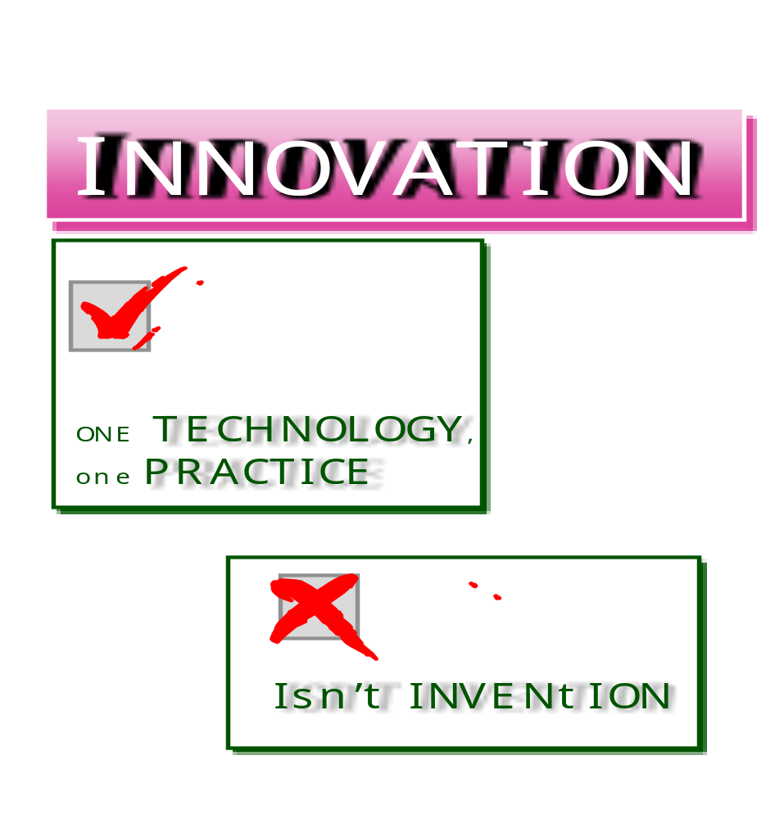
Notes:
So, innovation is one of the aspects which generates more business ideas. Taking into account the contents of the slide, we are not talking about inventing anything.

Slide 4
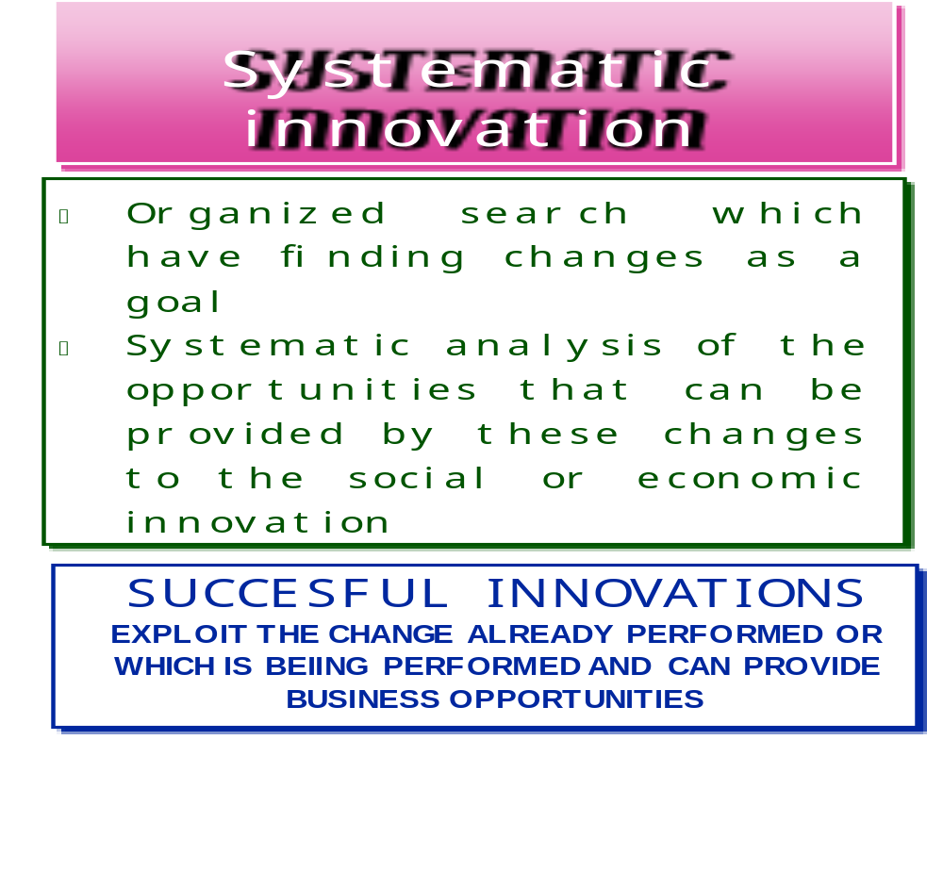
Notes:
Definition of Innovation and its relationship with the entrepreneur role

Slide 5
Systematic INNOVATION = OBSERVAtION/EXPLORAtION
PETER DRUCKER'S INNOVATION WHEEL
3.-PROCESSES
2.- INCONGRUOUS
4.- SUDDEN
CHANGES
1.- UNEXPECTED
OBSERVATION/
EXPLORATION
5.- CHANGES OF
THE POPULATION
7.- NEW KNOWLEDGE
6.- CHANGES IN THE PERCEPTION
MODALITY OR
MEANING
EXTERNAL SCOPE of business.
INTERNAL SCOPE of business.

Slide 6
1.- UNEXPECTED
UNEXPECTED SUCCESS
CONTROL THAT UNEXPECTED FACTS ARE PROPERLY INFORMED
ORGANIZE A SEARCH
(Mount a search and analysis process)
LEARN WHAT DOES IT DEMAND TO BUSINESS
( Dedication, resources)
UNEXPECTED FAILURE
OBSERVATION
(Own failure or a competitor’s one)
More than understand the failure reason, understand how the failure can be beaten through innovation
EXTERNAL EVENT
OBSERVE THE CHANGE AND TAKE ADVANTAGE OF IT
Search + organization + directed to innovation
Exploitation with resources

Slide 7
2.-INCONGRUITIES
OF ECONOMIC REALITIES
IF THE ECONOMIC RESULTS OF AN INDUSTRY OR SERVICE DO NOT COINCIDE WITH AN INCREASE OF THE DEMAND OF THESE PRODUCTS OR SERVICES
OF THE REALITY COMPARED TO WHAT IT IS SUPPOSED TO BE
ORIGINATES A BAD SITUATION IN THE BUSINESS DUE TO AN EXCESS OF DEDICATION OF RESOURCES IN A WRONG DIRECTION
BETWEEN THE PERCEPTION OF THE VALUES OF THE CLIENTS AND THE REALITY OF THEM
INSIDE THE PACE AND LOGIC OF A PROCESS
PRODUCED BY SOME THING THAT IS NOT WORKING, IS DIFFICULT OR COMPLEX INSIDE A PACE OR PROCESS.

Slide 8
3.- PROCESSES
INNOVATION = IMPROVEMENT OF ALREADY EXISTENT PROCESSES
SUCCESFUL
INNOVATION
REQUIRES:
→ CLEAR/DEFINED PROCESS
→ A WEAK LINK OF THE PROCESS
→ CLEAR IMPROVEMENT GOALS
→ DEFINE CLEARLY THE SPECIFICATIONS OF THE BEST CONSIDERED SOLUTION
→ HIGH RECEPTION LEVEL OF THE ACTORS OF THE NEW IMPROVED PROCESS.

Slide 9
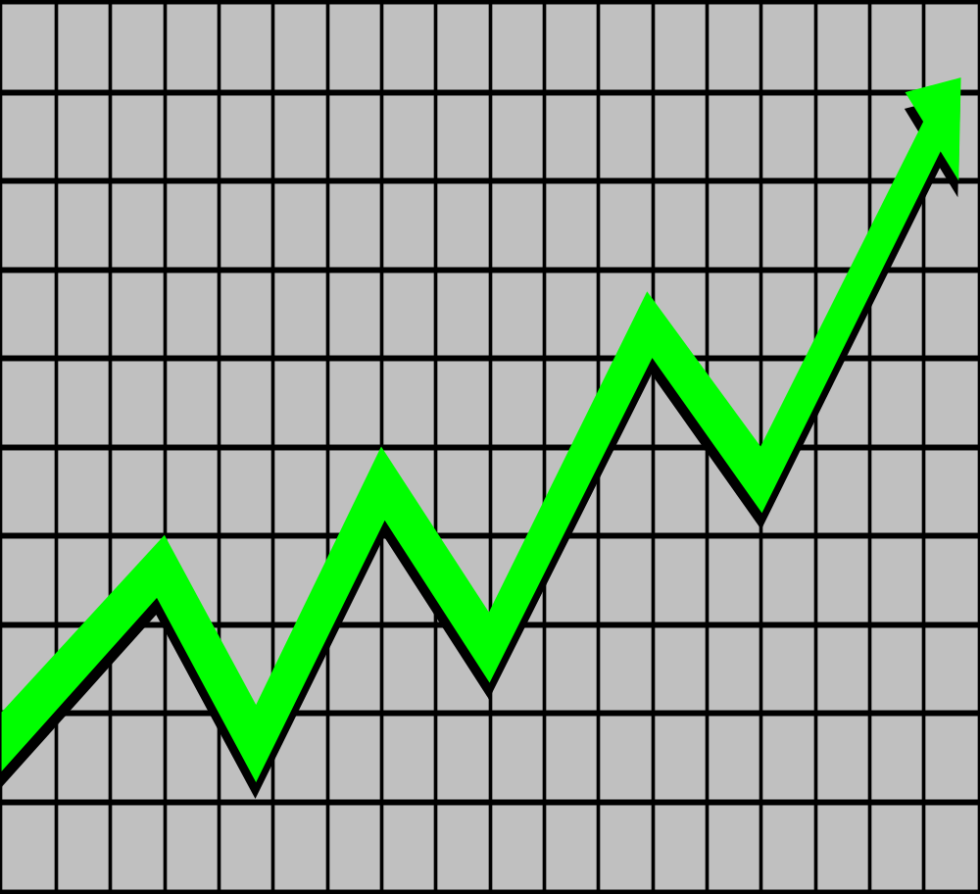
4.- INDICATORS OF CHANGE OF THE STRUCTURE OF THE INDUSTRY OR MARKETS
→ FAST GROWTH OF AN INDUSTRY
( More important than: economy, population)
→ SUSTAINABLE GROWTH OF AN INDUSTRY WITHOUT IMPORTANTSELF-MODIFICATIONS.
( These ones which continue in the industry usually do not appreciate
the change and only observe a natural growth)
→ TECHNOLOGIES CONVERGENCE IN A
PRODUCT OR SERVICE.
→ IF THE COMMERCIALIZATION OR SERVICE PROVIDING MECHANISMS CHANGE FREQUENTLY

Slide 10
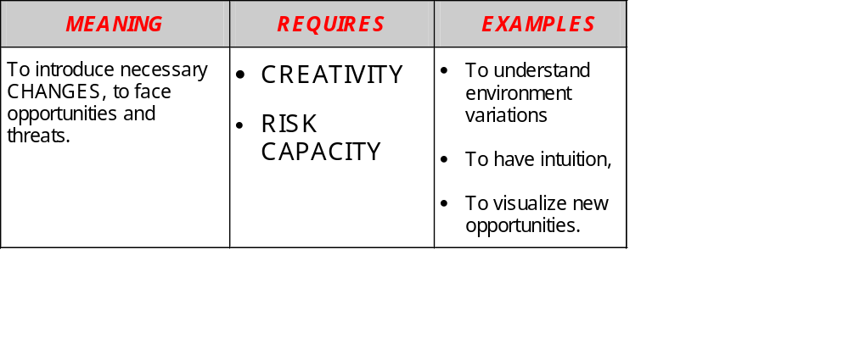
CHANGES in the
EXTERNAL ENVIRONMENT
of the Business
5.- CHANGES IN
THE POPULATION
6.- CHANGES IN THE PERCEPTION
MODALITY OR MEANING
7.- NEW KNOWLEDGE

Slide 11
MULTIDIMENSIONAL
REALITY
It means that, in spite of the existence of ”DIRECTING” Events/Tendencies, multiple ¿Secondary? ... effects are generated, and they compound the reality.
“DIRECTING”
TENDENCE
MACRO-TENDENCE
MULTIPLE BUSINESS OPPORTUNITIES OUT OF THE DIRECTING TENDENCE or
MACRO-TENDENCE

Slide 12
CURRENT TENDENCIES OF BUSINESS ACTIVITIES
NOT MAKING BASIC ERRORS
“DIRECTING”
TENDENCE
MACRO-TENDENCE
ITS IDENTIFICATION
ALLOWS
IDENTIFYING AN OPPORTUNITY
* CURRENT TENDENCIES OF BUSINESS ACTIVITIES IN THE EARLY YEARS OF THE 2000 DECADE
- OFFSHORING/FLEXIBILITY.
- INTERNATIONALIZATION
- SERVICES
- NEW APPLIED TECHNOLOGIES
- PROCESSES SEGMENTATION
- NEW PRODUCTS FOR NEW NEEDS

Slide 13
Business Ideas generation techniques: brainstorming and idea tests

Slide 14
BRAINSTORMING
Basic steps to generate ideas through group discussions:
Group meeting with friends, colleagues or relatives with very different precedents, experiences and aptitudes.
Prepare the group for the meeting. Inform some days before about problems to discuss in order to allow the unconscious mind searching creative solutions.
Differentiate between idea generation (creation) and idea refining, encouraging freedom when they are expressed. Do not evaluate if they are good or bad ideas.
Emphasize in the quantity and not in the quality of the generated ideas. Accept silly, absurd, mediocre and good ideas. Each participant can think about 25 commercial ideas and write them into a sheet. Do not deliver quality judgements as it will decrease creativity.
Each participant have to take the ideas from others as a basis.
Classify the ideas when the meeting is finished. After the selection process, reflect on, group and develop them and later choose the ones you consider are the best ones.

Slide 15
EMPIRIC RULES FOR CREATIVITY
(From the book "The great idea" of Charles "Chic" Thompson)
1.- The best way to have a good idea is to uncover many ideas and discard the non-convincing ones.
2.- To search ideas which are 15 minutes in advance... and not light years in advance.
3.- Search always a second correct answer.
4.- If you are not successful when starting, take a break!
5.- ¡Write down your ideas before forgetting them!
6.- If everybody says you are wrong, then you one step in advance.
7.- The answer for any problem pre-exists. We have to formulate the correct question in order to discover the answer (Jonas Salk).
8.- When someone formulates a silly question, he gets an intelligent answer (Aristotel).
9.- Never solve a problem from its original perspective.
10.- Visualize your problem and solve it (mentally) before solving it (really).
11.- Any behaviour is developed according to opposite poles... Learn to see things back down, inside-outside and vice versa. Lao-tsé, in "Tao-te Ching"

Slide 16
12.- Challenging a supposition can transform obstacles into opportunities (a waiter who makes a mistake serving a dish compensates the customer with a free desert: client service policy of the Restaurant.)
13.- If different shoes do not give any result, try to observe if your problem is caused by an helicopter... or a spaceship (perspectives change).
14.- Think like nature. Question yourself about: “¿How will the nature solve this problem?”
(Jonas Salk)
15.- Take the best, then adapt it (Tom Peters) (become an idea gatherer. Overcome mental blocks¹. You can innovate on borrowed ideas. Opposite to the Not Invented Here syndrome).
16.- Be sure that the sanction for failing is not greater than the sanction for doing nothing.
(After falling in love with an idea, you have to be also ready to discard it).
17.- Writing your ideas is like putting money in a bank (exclusive notebook with colourful tabs and areas of ideas).
18.- Start always a meeting of sixty minutes with a warming-up exercise of one minute.

Slide 17
BUSINESSMAN - IDEA TEST
THE CREATOR
Propose the idea about
goods or services (product)
Potential clients
previous information about some people who know well these clients.
INFORMATION ABOUT:
- Ideal characteristics of the product, (price, attributes, configuration).
- Other key factors for success.
- Market size.
Source: CEOE Cómo crear una empresa
Notes:
Preparation of the information to generate ideas, meeting with potential clients and people with knowledge about different sectors

Slide 18
IDEA TEST
Which services could they provide and which needs could they satisfy?
What are the characteristics of my product or service?
What types of clients could be interested?
Information to be gathered
Ideal characteristics of the product or service.
Evolution factors
Other success key factors
What people know well these clients and could provide us information about their behaviour?
Fuente: CEOE Cómo crear una empresa
Notes:
Thinking about the possibility that my idea is able to provide a service or not.

